Slide 1
LOGICAL CLOCKS
Synchronization mechanisms in Distributed Systems

Slide 20
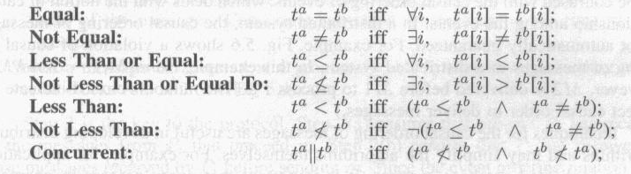
Comparing Vector Timestamps

Slide 35
Causal Ordering of Messages
The causal ordering of messages tries to maintain the same causal relationship that holds among “message send” events with the corresponding “message receive” events
In other words, if Send(M1) → Send(M2), then Receive(M1) →Receive(M2)
This is different from the causal ordering of events

Slide 36
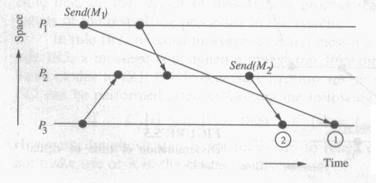
Causal Ordering of Messages

Slide 37
Causal Ordering of Messages
The basic idea
It is very simple
Deliver a message only when no causality constraints are violated
Otherwise, the message is not delivered immediately but is buffered until all the preceding messages are delivered

Slide 38
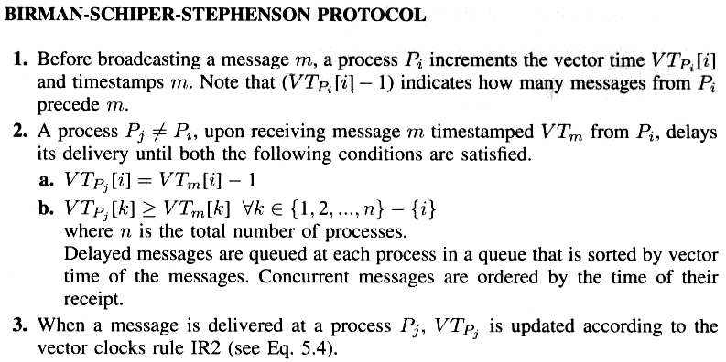
Birman-Schiper-Stephenson Protocol

Slide 39
Birman-Schiper-Stephenson Protocol
If a message m is received from P_{i,} you should also have received every message that P_{i} received before it sent m; e.g.,
If m is sent by P₁ and ts(m) is (3, 4, 0) and you are P₃, you should already have received exactly 2 messages from P₁ and at least 4 from P₂
If m is sent by P₂ and ts(m) is (4, 5, 1, 3) and if you are P₃ and VC₃ is (3, 3, 4, 3) then you need to wait for a fourth message from P₂ and at least one more message from P₁.

Slide 40
Enforcing Causal Communication
P0
VC₀
VC₀
(1, 0, 0)
m
(1, 1, 0)
P1
(1, 1, 0)
VC₁
m*
P2
(0, 0, 0)
(1, 0, 0)
(1, 1, 0)
VC2
VC2
VC₂
P1 received message m from P0 before sending message m* to P2; P2 must wait for delivery of m before receiving m*
(Increment own clock only on message send)
Before sending or receiving any messages, one’s own clock is (0, 0, …0)

Slide 41
Vector Time: Comparison
Vector timestamps are compared in the following manner:
TS_{i} < TS_{j} iff ∀ k, TS_{i}[k] ≤ TS_{j}[k] and k, TS_{i}[k] < TS_{j}[k].
eg [ (3,3,5) < (3,4,5) ]
An event e causally depends on an event e' iff
e'.TS < e.TS
Two events e and e' are concurrent iff
neither e'.TS < e.TS nor e.TS < e'.TS

Slide 42
Time
e11
e12
P1
(1, 0, 0)
(2, 0, 0)
P2
e21
e22
(0, 1, 0)
(2, 2, 0)
e31
e32
e33
P3
(0, 0,1)
(0, 0, 2)
(0, 0, 3)
ts(e11) = (1, 0, 0) and ts(e32) = (0, 0, 2), which shows that the two events are concurrent.
ts(e11) = (1, 0, 0) and ts(e22) = (2, 2, 0), which shows that
e11 e22

Slide 43
Matrix Clocks
Matrix clock:
Each event has n vector clocks, one for each process
The i th vector on process i is called process i ’s principle vector i.e. its own vector clock as before
Notes:
43

Slide 44
Matrix Time
In a system of matrix clocks, the time is represented by a set of n × n matrices of non-negative integers.
->Vector clock :
one-dimensional data structure
->Matrix clock :
Two-dimensional data structure
-> Message and computation overheads are high
-> Powerful and useful for applications in distributed system

Slide 45
Matrix Time
In a system of matrix clocks, the time is represented by a set of n × n matrices of non-negative integers.
A process p_{i} maintains a matrix mt_{i} [1..n, 1..n] where,
mt_{i}[i , i ] denotes the local logical clock of p_{i} and tracks the progress of the computation at process p_{i} .
mt_{i}[i , j ] denotes the latest knowledge that process p_{i} has about the local logical clock, mt_{j}[j , j ], of process p_{j} .
mt_{i}[j , k] represents the knowledge that process p_{i} has about the latest knowledge that p_{j} has about the local logical clock, mt_{k} [k, k], of p_{k}
The entire matrix mt_{i} denotes p_{i}’s local view of the global logical time.

Slide 46
Matrix Time
Process p_{i} uses the following rules R1 and R2 to update its clock:
R1: Before executing an event, process p_{i} updates its local logical time as follows:
mt_{i}[i , i ]:= mt_{i}[i , i ] + d (d > 0)
R2: Each message m is piggybacked with matrix time mt. When p_{i} receives such a message (m,mt) from a process p_{j}, p_{i} executes the following sequence of actions:
Update its global logical time as follows:
(a) 1 <= k<=n : mt_{i} [i , k] := max(mt_{i}[i , k], mt[j , k])
(b) 1 <=k,l <=n : mt_{i}[k, l]:= max(mt_{i}[k, l ], mt[k, l ])
Execute R1.
Deliver message m.

Slide 47
Matrix Clock Example
(1,0,0)
(0,0,0)
(0,0,0)
(2,0,0)
(0,0,0)
(0,0,0)
(3,0,0)
(0,0,0)
(0,0,0)
user1 (process1)
(2,0,0)
(2,3,2)
(0,0,2)
(0,0,0)
(0,1,0)
(0,0,0)
(0,0,0)
(0,2,2)
(0,0,2)
(2,0,0)
(2,4,2)
(0,0,2)
user2 (process2)
(0,0,0)
(0,0,0)
(0,0,1)
(0,0,0)
(0,0,0)
(0,0,2)
(2,0,0)
(2,4,2)
(2,4,3)
user3 (process3)
Notes:
47

Slide 48
Compute the matrix clock values
Time
P1
e11
e12
e13
P2
e21
e22
e23
e24
e25
P3
e32
e33
e34
e31

